Slide 1

Saicharan Karri,24
Educational Qualification:
Post Graduation : Data Analytics and Machine Learning, Imarticus.
Graduation : Civil Engineering, IARE.
Professional Work Experience:
I started my career as an Analyst (Machine Learning and Operations) in Teleperformance for 1.9 years.

Slide 2
Brief Insight
Beginning in spring 2009, a pandemic caused by the H1N1 influenza virus swept across the world.
Researchers estimate that in the first year, it was responsible for between 151,000 to 575,000 deaths globally.
A vaccine for the H1N1 flu virus became publicly available in October 2009.
the United States conducted the National 2009 H1N1 Flu Survey. This phone survey asked respondents whether they had received the H1N1 and seasonal flu vaccines, in conjunction with questions about themselves.
A better understanding of how these characteristics are associated with personal vaccination patterns can provide guidance for future public health efforts.
Notes:
The first case was reported in Mexico on march 18.
GSK - Glaxo Smith Klne

Slide 3
Contents
01
06
02
07
03
08
04
09
05
10
11
Problem Statement
Evaluating the Model Performance
Walkthrough
Functioning of Algorithms - Decision Tree and Random Forest
Missing Value Imputation
Functioning of Algorithms - Support Vector Machines and Gradient Boosting Machine
Visualizing the Target Variables
Performance Metrics of Algorithms on Seasonal Vaccine
Balancing the Imbalanced Data
Performance Metrics of Algorithms on H1N1 Vaccine
Conclusion

Slide 4
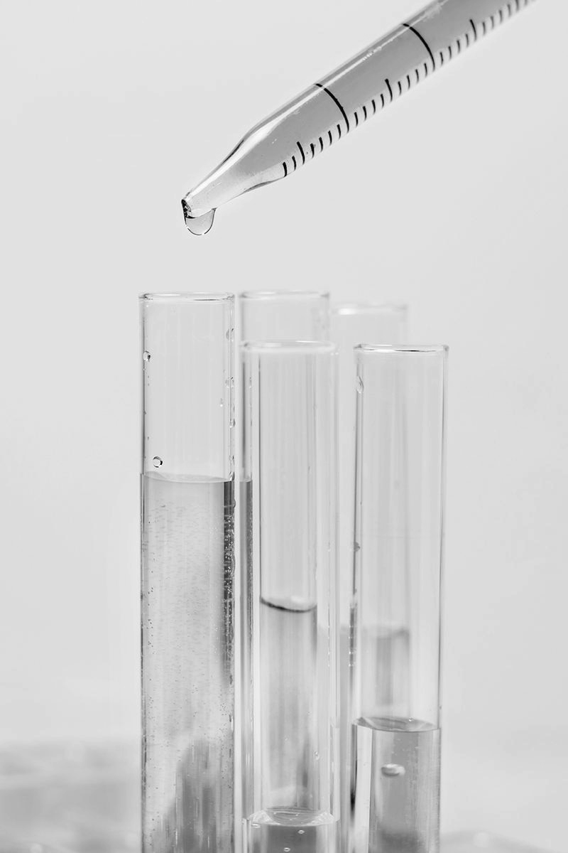
Problem Statement
To predict how likely individuals are to receive their H1N1 and seasonal flu vaccines.
h1n1_vaccine
seasonal_vaccine
Notes:
Motivation behind choosing this dataset:
It has two target variables (imbalanced and balanced)
Some of the variables were more than 60 percent missing
Some features are related to general characteristics of the people like wearing mask, touching face
Some features are related to concerns and opinions on the vaccine shots
Some features are related to demographic information such as sex, education , employment status, age group

Slide 5
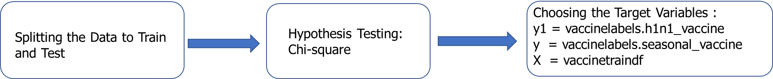
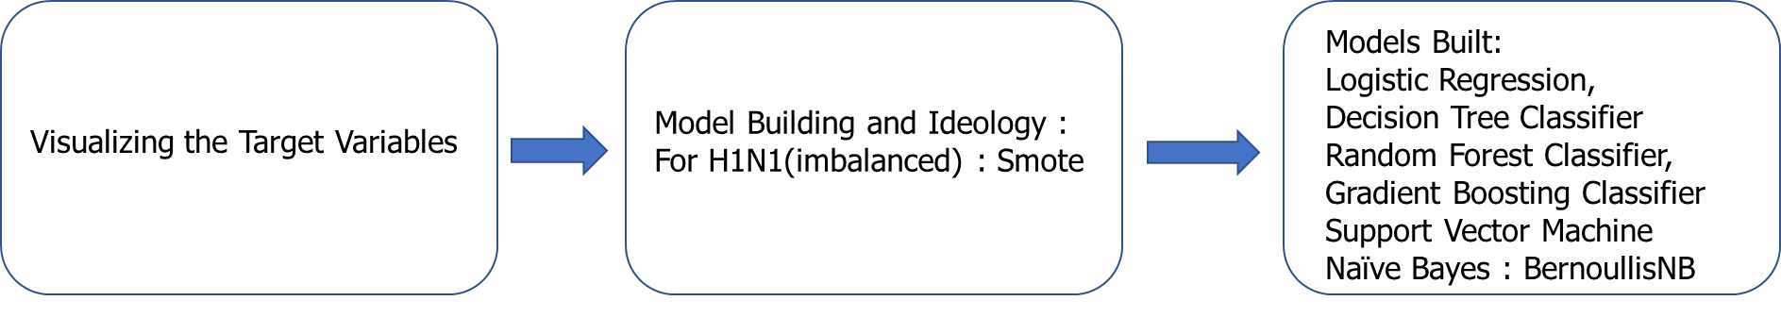
Walkthrough

Slide 6
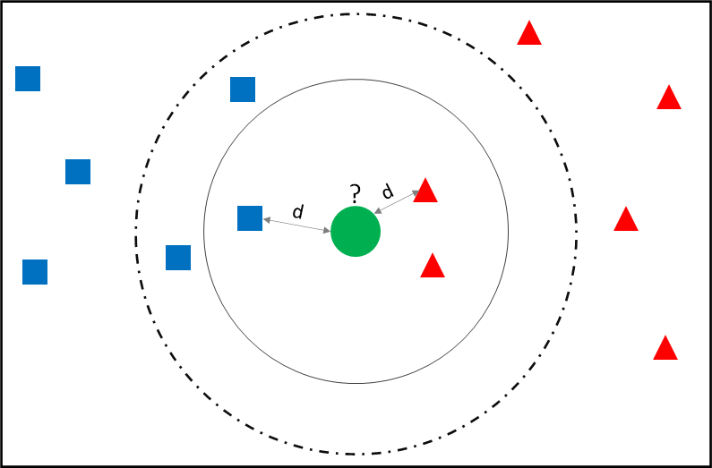
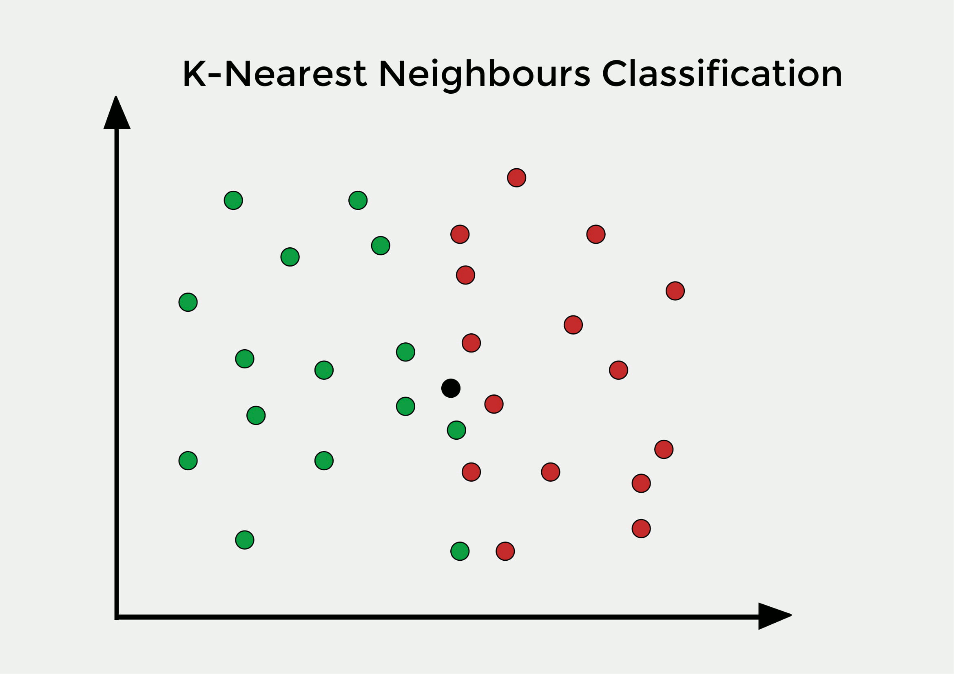
Missing Value Imputation
KNN Imputer
Notes:
Every variable in my dataset is categorical, and the variables are about each person's personal information, such as behavior and opinions. The variables are likewise separated into two and five levels. imputing the level of variables by mean/median level of variables may not necessarily be an appropriate strategy.
So I used KNN imputer to deal with missing values.
KNN is a non parametric algorithm that uses Euclidean distance to calculate distance between missing value and closes 5 neighbors (rows) and smallest value is imputed
Before running the KNN imputer label encoding of Categorical and Object data must be done.

Slide 7
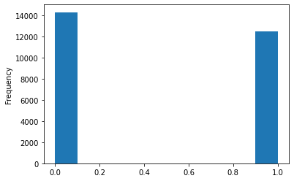
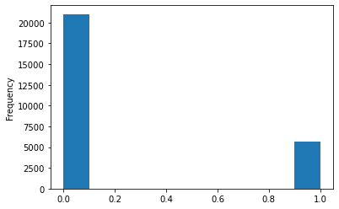
Visualizing the Target Variables
Seasonal Vaccine
H1N1_Vaccine

Slide 8
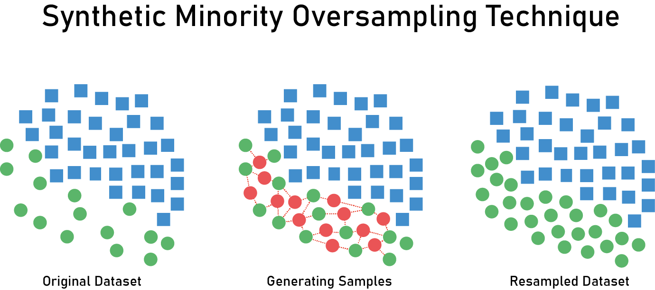
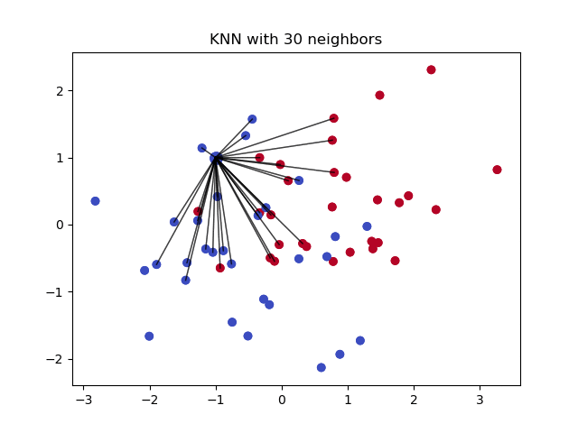
Balancing the Imbalanced Data
Notes:
Impact of Imbalanced data on ML Algorithms:
The problem with training the model with an imbalanced dataset is that the model will be biased towards the majority class only. This causes a problem when we are interested in the prediction of the minority class
Smote:
It uses KNN methodology and creates synthetic artificial data that lies in the range of 0 and 1.
It takes the difference between the two data points and multiply it with a random number between 0 to 1

Slide 9
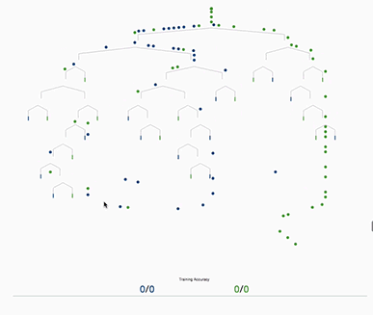
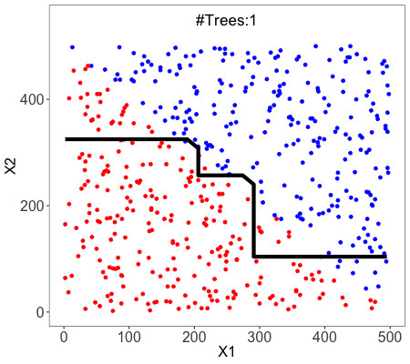
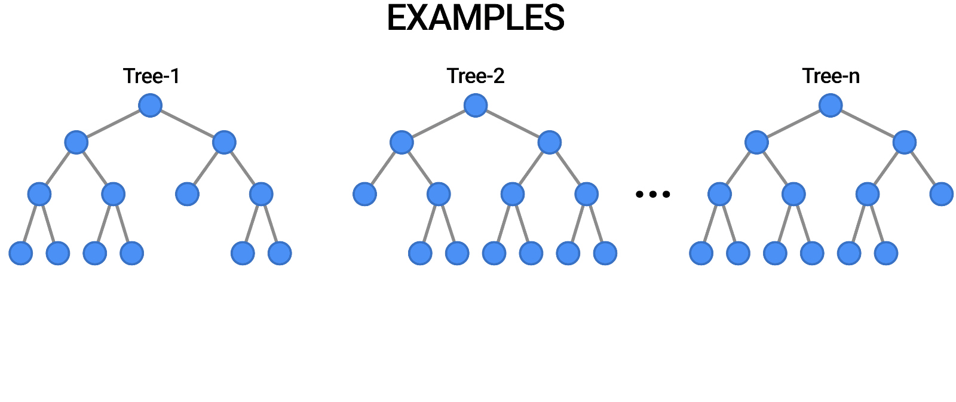
Functioning of Algorithms
Decision Tree and Random Forest

Slide 10
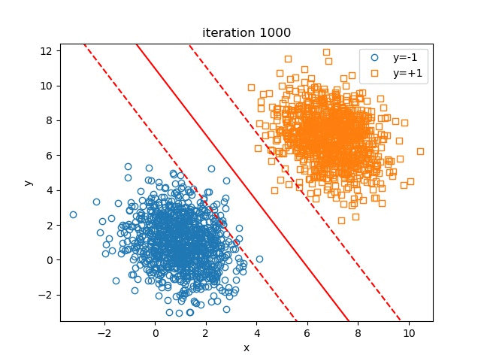
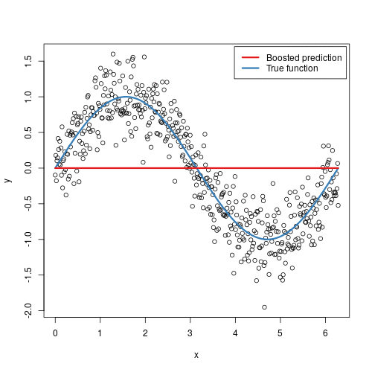
Functioning of Algorithms
Support Vector Machine
Gradient Boosting Machine

Slide 11

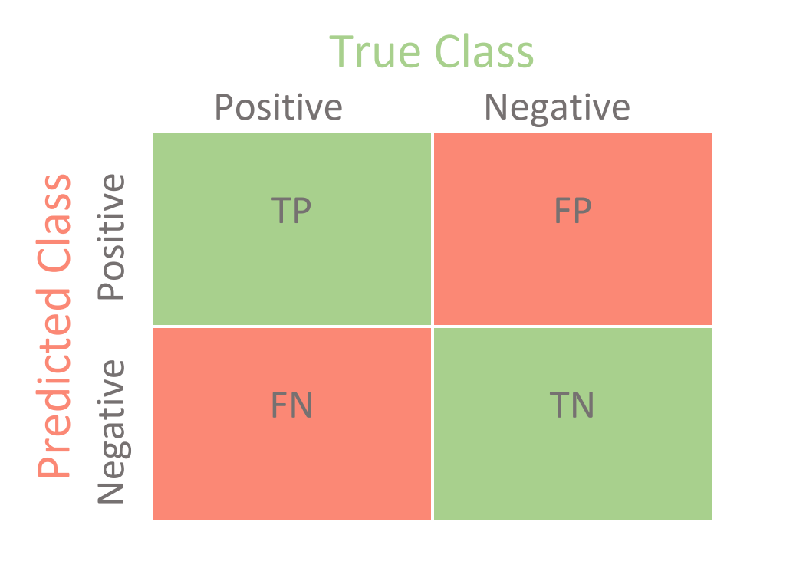
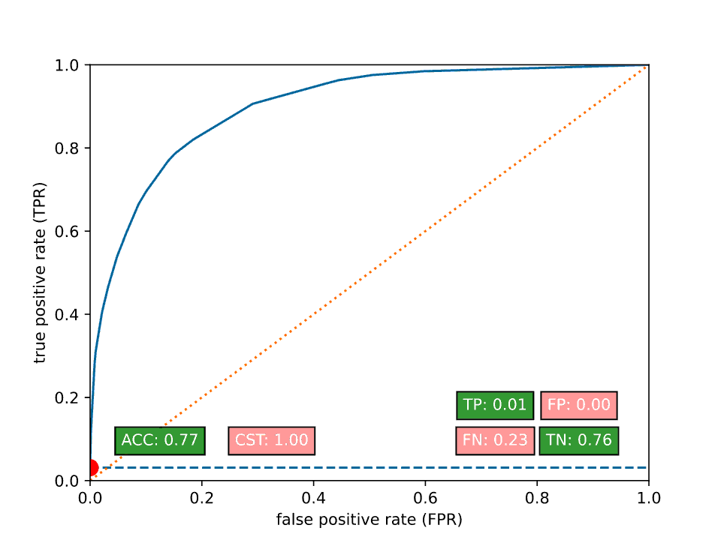
Evaluating the Model Performance
Performance Metric : AUROC or AUC
Sensitivity, Specificity plays a major role behind AUC-ROC
Notes:
As the problem statement is to forecast how likely people are to get H1N1 and seasonal flu vaccines, our model's major goal is to reduce the False Negative Rate, also known as Recall.
Recall summarizes how well the positive class was predicted and is the same calculation as sensitivity.
Recall = True Positive / (True Positive + False Negative)

Slide 12
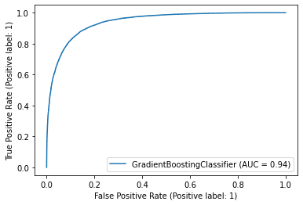
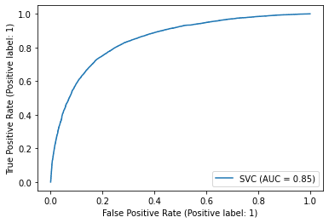
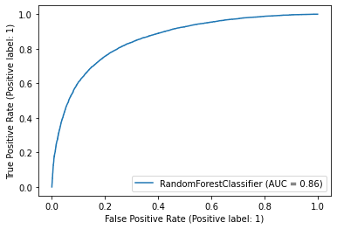
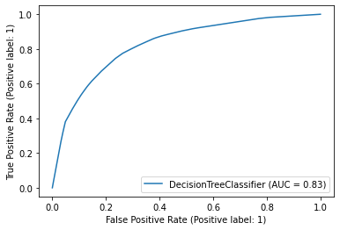
Performance Metrics of Algorithms on Seasonal Vaccine
Algorithm | Recall Values |  | FN (Type II Error) | AUC
 | 0 | 1
GBM | 0.88 | 0.85 | 1870 | 0.94
Random Forest | 0.81 | 0.75 | 3117 | 0.86
SVM | 0.81 | 0.74 | 3228 | 0.85
Decision Tree | 0.76 | 0.75 | 3169 | 0.83

Slide 13
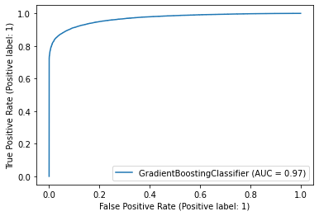
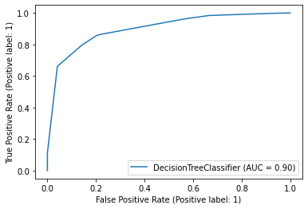
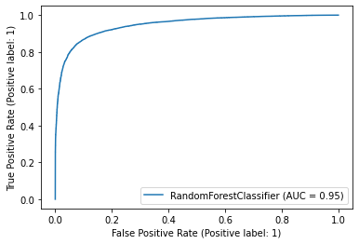
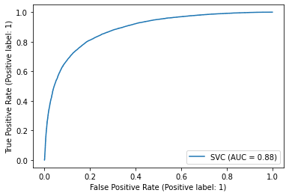
Performance Metrics of Algorithms on H1N1 Vaccine
Algorithm | Recall Values |  | FN (Type II Error) | AUC
 | 0 | 1
GBM | 0.95 | 0.88 | 2609 | 0.97
Random Forest | 0.92 | 0.85 | 3184 | 0.95
Decision Tree | 0.80 | 0.86 | 3032 | 0.90
SVM | 0.81 | 0.81 | 4045 | 0.88

Slide 14
Conclusion
Out of all the Algorithms ran, Gradient Boosting Classifier with n-estimators 5000 on Seasonal Vaccine and n-estimators 270 on H1n1 Vaccine has performed good
I entered the predicted test values into the competition Flu Shot Learning: Predict H1N1 and Seasonal Flu Vaccines on the driven.org website. Of all of the models The most accurate classification method is gradient boosting with accuracy 0.7534

Slide 15
Thank You

